Slide 1

OPERATION ON
DATA TYPE
PYTHON
Abhinash Mishra

Slide 2
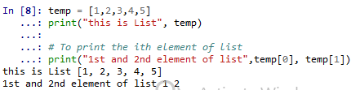
List
•
•
In python, lists are part of the standard language.
We could store multiple values in a single object. Lets say we would like to store a sequence of
numbers/Id’s, this could be achieved by lists
List and Stacks, both are same in python
•
–
–
–
>>> l = [1, 2, 3]
>>> l[0]
1
It is initiated with brackets []
To access first element, we have to use bracket
as index .

Slide 3


List
•
To insert an element at ith place
–
–
temp.insert(3,9)
print("List after insertion",temp)
•
To append element to list we use append, this corresponds to push when we use list as stack
–
–
temp.append(10)
print("After append the list is",temp)

Slide 4


List
•
To find index of any element
–
–
–
print(temp)
index = temp.index(5)
print("Index of 5 is ", index)
•
To remove an element
–
–
–
print(temp)
temp.remove(5)
print("List after removing 5",temp)

Slide 5


List
•
To reverse the list
–
–
–
print(temp)
temp.reverse()
print("List after reversing", temp)
•
To sort the list
–
–
–
print(temp)
temp.sort()
print("Sorted list",temp)

Slide 6


List
•
To remove last element of list or pop the element from stack
–
–
–
print(temp)
temp.pop()
print("List after pop",temp)
•
Nested lists
–
–
nested = [[1,2,3],[2,3,4],[5,6,7]]
print("Nest list",nested)

Slide 7
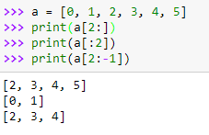
List
•
To slice ->Slicing uses the symbol : to access to part of a list:
>>> list[first
index:last index:step]
>>> list[:]
Last element is accessed through -1

Slide 8
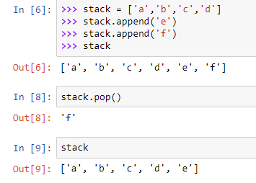
List as stacks
Lists is treated as stacks, that is a last-in, first-out data structures (LIFO).
An item can be added to a list by using the append() method.
The last item can be removed from the list by using the pop() method without passing any index to it.

Slide 9
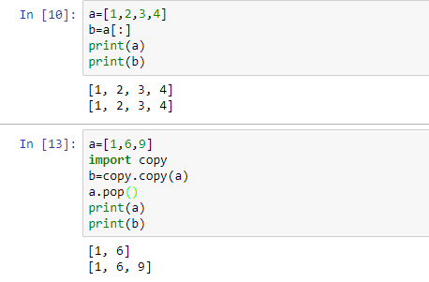
How to copy a list
•
There are three ways to copy a list:
Even the last item of “a”
is popped out, the value
of “b” which was copied
earlier, remained intact.

Slide 10
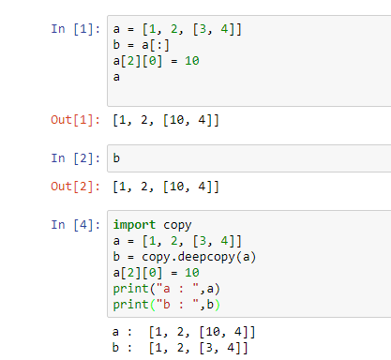
How to copy a list
•
The preceding techniques for copying a list create shallow copies. It means that nested objects will
not be copied. Consider this example:
Here, the value of “a” is
changed after copying.
But the value of “b” also
changed correspondingly
So, to counter such
changes, “deepcopy”
function is used

Slide 11

Dictionary
•
The other main data type is the dictionary. The dictionary allows you to associate one piece of data (a
"key") with another (a "value"). The analogy comes from real-life dictionaries, where we associate a
word (the "key") with its meaning. It's a little harder to understand than a list, but Python makes
them very easy to deal with.
It is best to think of a dictionary as an unordered set of key: value pairs, with the requirement that the keys are unique (within one dictionary).
A pair of braces creates an empty dictionary: {}
Placing a comma-separated list of key : value pairs within the braces adds initial key : value pairs to the dictionary; this is also the way dictionaries are written on output.
Declaration of dictionary
•
•
•
•
▪
Lets say we would like to create an object which stores the name and scores of students. This
could be achieved with dictionary in keys : values format
•
•
score = {'rob' : 85, 'kevin' : 70}
print("The dictionary is",score)

Slide 12
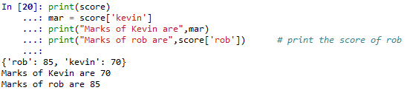
Dictionary
•
To get the score of any student or value in dictionary
–
–
–
–
print(score)
mar = score['kevin']
print("Marks of Kevin are",mar)
print("Marks of rob are",score['rob'])
# print the score of rob

Slide 13

Dictionary
•
Add new elements or students to the dictionary
–
–
–
–
print(score)
score['jim']= 92
score['tomy']= 56
print("The dictionary after adding jim and tomy -",score)

Slide 14

Dictionary
•
“keys” gives you keys in dictionary, i.e. names of all students in this case
–
–
–
print(score)
names = list(score.keys())
print("List of students -",names)

Slide 15

Dictionary
•
“values” gives you values in dictionary, i.e. marks of all students in this case
–
–
–
print(score)
marks = list(score.values())
print("List of marks -",marks)

Slide 16

Dictionary
•
We can also look at the marks in sorted order i.e. non descending order
–
–
–
print(score)
sortedMarks = sorted(score.values())
print("List of marks in sorted order -",sortedMarks)

Slide 17


Dictionary
•
Checks if a particular student name is there in the dictionary
–
–
–
print(score)
check = 'kory' in score
print("If kory is there in dictionary -",check)
check2 = 'jim' in score
print("If jim is there in dictionary -",check2)

Slide 18
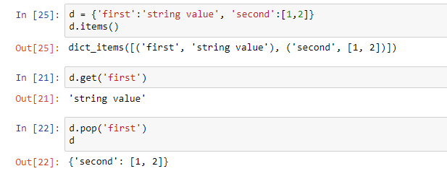
Dictionary
In addition to keys and values methods, there is also the items method that returns a list of items of
the form (key, value). The items are not returned in any particular order.
In order to get the value corresponding to a specific key, use get or pop :
The difference between get and pop is that pop also removes the corresponding item from the dictionary

Slide 19
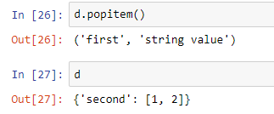
Dictionary
popitem removes and returns a pair (key, value); you do not choose which one because a dictionary
is not sorted :

Slide 20
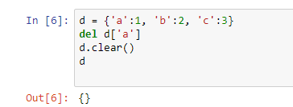
Dictionary
To create a new object, use the copy method (shallow copy):
-> d2 = d1.copy()
You can clear a dictionary (i.e., remove all its items) using the clear() method:
-> d2.clear()
The clear() method deletes all items whereas del() deletes just one:
All the values of “d” is
cleared by the function
“clear”

Slide 21

Queue
•
A queue is a first in, first out (FIFO) structure. This means that the first item to join the queue is the
first to leave the queue.
Importing & declaring a queue
•
–
–
–
from collections import deque
queue = deque(["aa", "bb", "cc"])
print(queue)

Slide 22

Queue
•
Appending element to queue
–
–
–
queue.append("dd")
queue.append("ee")
print("After appending dd and ee, queue is",queue)

Slide 23
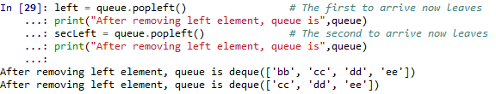
Queue
•
Removing left element from queue
–
–
–
–
left = queue.popleft()
# The first to arrive now leaves
print("After removing left element, queue is",queue)
secLeft = queue.popleft()
# The second to arrive now leaves
print("After removing left element, queue is",queue)

Slide 24
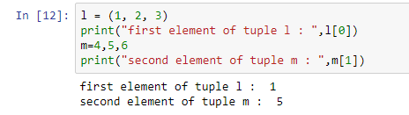
Tuples
In Python, tuples are part of the standard language. This is a data structure very similar to the list data
structure. The main difference being that tuple manipulation are faster than list because tuples are
immutable.
To create a tuple, place values within brackets:
It is also possible to create a
tuple without parentheses,
by using commas:
To create a tuple with a single element, you must use the comma:
>>> singleton = (1, )

Slide 25
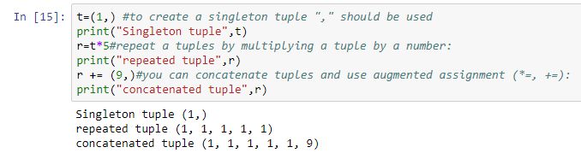
Tuples
Since the tuple is multiplied by 5, it
has grown into size 5 tuple from
singleton tuple
9 as value of singleton tuple , is
added at the end of tuple

Slide 26
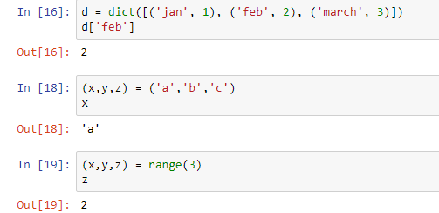
Tuples
Tuples are useful because there are
•
•
•
faster than lists
protect the data, which is immutable tuples can be used as keys on dictionaries
In addition, it can be used in different useful ways:
1. Tuples as key/value pairs to build dictionaries
Dictionary is created using tuples
Multiple values can be assigned
using tuples
“range” function generates sequence
of numbers. E.g. range(3) = (0,1,2)

Slide 27
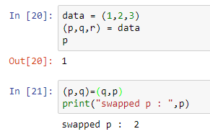
Tuples
Tuple Unpacking
Tuple unpacking allows to extract tuple elements automatically is the list of variables on the left has the same number of elements as the length of the tuple
Tuple can be use as swap function
This code reverses the contents of 2
variables p and q:

Slide 28
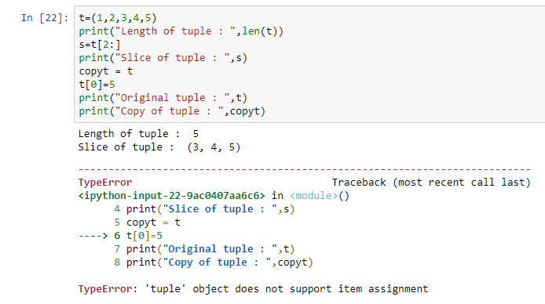
Tuples
Length
To find the length of a tuple, you can use the len() function:
>>> t= (1,2,3,4,5)
>>> len(t)
5
Tuple is immutable. So, we
can’t assign values to it.
Slicing (extracting a segment)
>>> t = (1,2,3,4,5)
>>> t[2:]
(3, 4, 5)
Copy a tuple
To copy a tuple,:
>>> t = (1, 2, 3, 4, 5)
>>> newt = t
>>> t[0] = 5
>>> newt
(1, 2, 3, 4, 5)

Slide 29
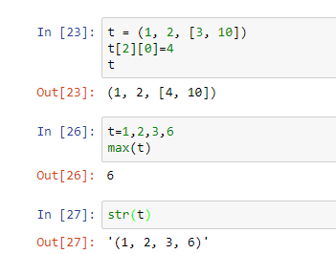
Tuples
Tuple are not fully immutable !!
If a value within a tuple is mutable, then you can change it:
>>> t = (1, 2, [3, 10])
>>> t[2][0] = 9
>>> t
(1, 2, [9, 10])
Math and comparison
comparison operators and mathematical functions
can be used on tuples. Here are some examples:
>>> t = (1, 2, 3)
>>> max(t)
3
Convert a tuple to a string
You can convert a tuple to a string by:
>>> str(t)

Slide 30
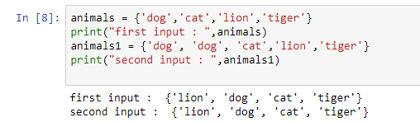
Sets
•
Sets are constructed from a sequence (or some other iterable object). Since sets cannot have
duplicated, there are usually used to build sequence of unique items (e.g., set of identifiers).
“dog” is repeated two times,
but sets cannot keep
duplicate item, so one “dog”
is removed
•
•
•
Sets are mutable unordered sequence of unique elements
Sets are constructed from a sequence (or some other iterable object)
Since sets cannot have duplicated, there are usually used to build sequence of unique items

Slide 31
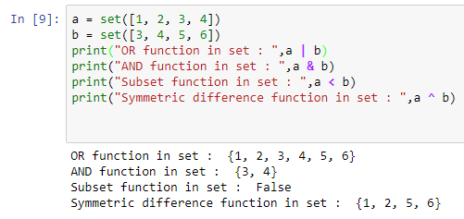
Sets
•
Quick look
“OR” combines all the element and
takes unique value of combined element
“AND” picks all the elements which are
Common in both the sets
“<” function looks, if all the elements of
“a” is present in “b”
“^” function combines all the element and removes all the common element

Slide 32
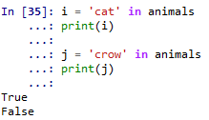
Sets
•
Sets are iterable
–
–
i = 'cat' in animals
print(i)
–
–
j = 'crow' in animals
print(j)
animals contain( lion, cat,
dog and tiger. Since “cat” is
in “animals” set, the
statement is true. But crow
is not part of “animals” set,
so output is false.

Slide 33
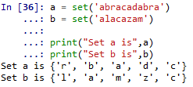
Sets
•
Set always give non-duplicate set of elements
–
–
a = set('abracadabra')
b = set('alacazam')
–
–
print("Set a is",a)
print("Set b is",b)

Slide 34


Sets
•
Letters in a but not in b
–
–
c = a - b
print("letters in a but not in b",c)
•
Letters in either a or b
–
–
d = a | b
print("letters in either a or b",d)

Slide 35


Sets
•
Letters in both a and b
–
–
e = a & b
print("letters in both a and b",e)
•
Letters in a or b but not both
–
–
f = a ^ b
print("letters in a or b but not both",f)

Slide 36
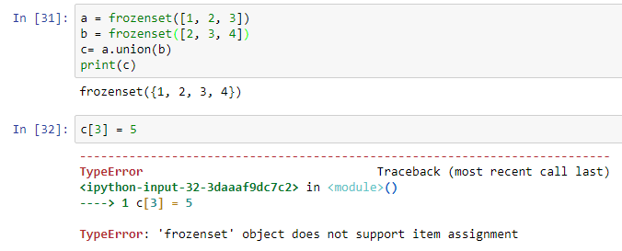
Frozensets
•
Sets are mutable, and may therefore not be used, for example, as keys in dictionaries.
•
Another problem is that sets themselves may only contain immutable (hashable) values, and thus
may not contain other sets.
Because sets of sets often occur in practice, there is the frozenset type, which represents immutable
(and, therefore, hashable) sets.
•
Frozenset is immutable. So,
we can’t assign values to it.

Slide 37

Frozensets
Frozensets : Using set as key in a dictionary
If you want to use a set as a key dictionary, you will need frozenset:
1 as key value, has been set
to fa (frozenset). It can be
retrieved.
Frozensets : Methods
frozensets have less methods than sets.
There are some operators similar to sets (intersection(), union(), symmetric_difference(), difference(), issubset(), isdisjoint(), issuperset()) and a copy() method.

Slide 38
A regular expression is a special sequence of characters that helps you match or find other strings or sets of strings, using a specialized syntax held in a pattern. Regular expressions are widely used in UNIX world
We would cover two important functions, which would be used to handle regular expressions. But a small thing first: There are various characters, which would have special meaning when they are used in regular expression. To avoid any confusion while dealing with regular expressions, we would use Raw Strings as r'expression'.
Python offers two different primitive operations based on regular expressions: match checks for a match only at the beginning of the string, while searchchecks for a match anywhere in the string (this is what Perl does by default).

